Slide 1
FT228/4 Knowledge Based Decision Support Systems
Knowledge Engineering
Ref: Artificial Intelligence A Guide to Intelligent Systems, Michael Negnevitsky – Aungier St. Call No. 006.3
Notes:
Choosing right tool for job

Slide 2
What is knowledge engineering?
Davis’ law:
“For every tool there is a task perfectly suited to it”.
But…
It would be too optimistic to assume that for every task there is a tool perfectly suited to it.
Notes:
Need guidelines for selecting right tools for given problem

Slide 3
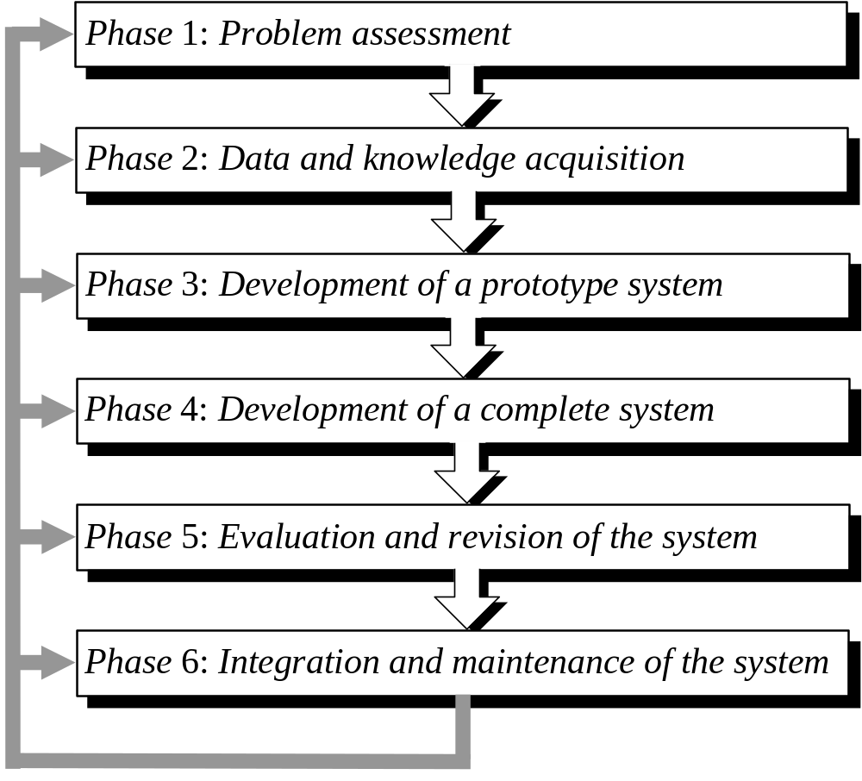
The process of knowledge engineering
Notes:
More of an art than engineering
Not neat and clean
All phases overlap
Need to look at each in more detal

Slide 4
Phase 1: Problem assessment
Determine the problem’s characteristics.
Identify the main participants in the project.
Specify the project’s objectives.
Determine the resources needed for building the system.
Notes:
Need a problem type, input output variables and their interaction, the form and content of the solution
Step one is to identify problem type

Slide 5
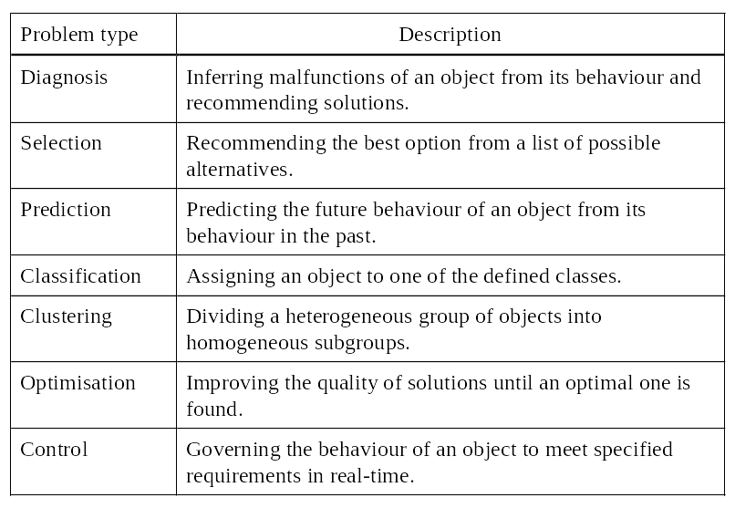
Typical problems addressed by intelligent systems
Notes:
Type of problem – influences out choice of the tool for building an intelligent system
Something to detect faults in an electrical circuit and guide user through diagnosis
Domain knowledge can often be represented as production rules and this a rule-based expert system could be the right candidate for solution
Choice of tool will also depend on the form and content of the solution
Systems build for diagnosis often require an explanation facility to enable them to justify their solutions
This is an essential component of an expert system but not of a neural network
Neural nets would be a good choice for classification and clustering problems where the result is often more important than understanding the reasoning process
Next step is to identify the participants
Knowledge engineer, domain expert
Then specify the objectives – gain competitive edge, improve decision making, reduce labour costs

Slide 6
Phase 2: Data and knowledge acquisition
Collect and analyze data and knowledge.
  Data may have to be massaged into form useful to tools chosen
Make key concepts of the system design more explicit.
Notes:
Data for intelligent systems is often collected from different sources and can be of different types
A particular tool for building an intelligent system requires a particular type of data
Some tools deal with continuous variables, others with several ranges, others normalised to single range
Some handle symbolic some only numeric
Some tolerate noisy some require clean

Slide 7
Phase 2: Data and knowledge acquisition
Issues
  Incompatible data.
    Data to analyse may store text in EBCDIC coding and numbers in packed decimal format
    Tools for building intelligent systems store text in the ASCII code and numbers as integers with a single- or double-precision floating point.
    Data transport tools
  Inconsistent data.
    Same facts are represented differently in different data bases.
  Missing Data
    Records often contain blank fields.
      Could attempt to infer some useful information from them.
      Can simply fill the blank fields in with the most common or average values.
      In other cases, the fact that a particular field has not been filled in might itself provide us with very useful information.
Notes:
If these differences are not
spotted and resolved in time, we might find
ourselves, for example, analysing consumption
patterns of carbonated drinks using data that does not
include Coca-Cola just because it was stored in a
separate database.
Choice of tool to build will depend on the acquired data.
e.g. estimating the market value of a property could be addressed by both an expert system and neural network technology
If we can get data about recent prices then we could train neural net rather than expert system
Data acquisition is not knowledge acquisition but is closely tied

Slide 8
Knowledge acquisition
Start with reviewing documents and reading books, papers and manuals related to the problem domain.
Collect further knowledge through interviewing the domain expert.
Knowledge acquisition is an inherently iterative process.
“Knowledge Acquisition Bottleneck”
Understanding the problem domain is critical for building intelligent system.
Notes:
We acquire knowledge as we acquire data
Then we study and analyse the acquired knowledge, and repeat the entire process again..
What happens in interview with domain expert ?
Expert is asked to identify four or five typical cases, describe how they solve each and explain or think out loud the reasoning behind each solution
Extracting information from human expert is difficult
Data acquired in second phase should enable us to describe the problem solving strategy at its most abstract, conceptual, level and choose a tool for building a proto-type

Slide 9
Difficulties
The expert
  knows more than he says
  says more than he knows
  lies to you
  disagrees with other experts
Knowledge engineers
  rush to structure
  need social skills
  need AI skills

Slide 10
Techniques
Interviews
Observe (Record) Performance
Protocol Analysis
Knowledge Engineer
System
Expert
Listen
Understand
Reformulate
Explain

Slide 11
Getting Started
For each problem to be addressed by the system:
  Determine the size and structure of the solution space
  How many categories of answers are there?
  How many specific choices within each category?
  Select a category, select a specific choice
  What factors suggest that choice as the correct one?

Slide 12
Phase 3: Development of a prototype system
Choose a tool for building an intelligent system.
Transform data and represent knowledge.
Design and implement a prototype system.
Test the prototype with test cases.
  A test case is a problem successfully solved in the past for which input data and an output solution are known.
  During testing, the system is presented with the same input data and its solution is compared with the original solution.
Notes:
Actually involves creating an intelligent system (small version) and testing it against a number of test cases
What is a prototype ?
A prototype system is defined as a small version of the final system.
It is designed to test how well we understand the problem − to make sure that the problem-solving strategy, the tool selected for building a system, and techniques for representing acquired data and knowledge are adequate to the task.
It also provides us with an opportunity to persuade the sceptics and, in many cases, to actively engage the domain expert in the system’s development.

Slide 13
Phase 4: Development of a complete system
Prepare a detailed design for a full-scale system.
Collect additional data and knowledge.
Develop the user interface.
Implement the complete system.
Notes:
The main work at this phase is often associated with adding data and knowledge to the system.
If, for example, we develop a diagnostic system, we might need to provide it with more rules for handling specific cases.
If we develop a prediction system, we might need to collect additional historical examples to make predictions more accurate.

Slide 14
Phase 5: Evaluation and revision of the system
Evaluate the system against the performance criteria.
Revise the system as necessary.

Slide 15
Evaluation
Intelligent systems are designed to solve problems that quite often do not have clearly defined “right” and “wrong” solutions.
To evaluate an intelligent system is , in fact, to assure that the system performs the intended task to the user’s satisfaction.
A formal evaluation of the system is normally accomplished with the test cases.
The system’s performance is compared against the performance criteria that were agreed upon at the end of the prototyping phase.

Slide 16
Phase 6: Integration and maintenance of the system
Interface with existing systems
Make arrangements for technology transfer.
Establish an effective maintenance program.
Notes:
Integrating the system into the environment where it will operate
interfacing the system with existing systems
Knowledge evolves over time
Who maintains the system
Knowledge engineer withdraws so there must be in-house expertise

